Slide 1
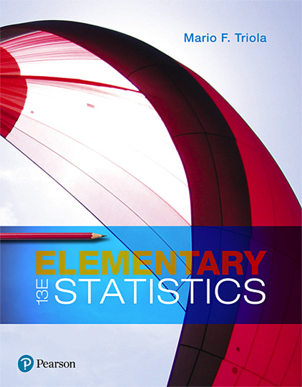
Elementary Statistics
Thirteenth Edition
Chapter 3
Describing, Exploring, and Comparing Data
Copyright © 2018, 2014, 2012 Pearson Education, Inc. All Rights Reserved

Slide 2
Describing, Exploring, and Comparing Data
3-1 Measures of Center
3-2 Measures of Variation
3-3 Measures of Relative Standing and Boxplots

Slide 3
Key Concept
This section introduces measures of relative standing, which are numbers showing the location of data values relative to the other values within the same data set.
The most important concept in this section is the z score.
We also discuss percentiles and quartiles, which are common statistics, as well as another statistical graph called a boxplot.

Slide 4
z Scores
z Score
A z score (or standard score or standardized value) is the number of standard deviations that a given value x is above or below the mean. The z score is calculated by using one of the following:
Sample
Population
or

Slide 5
Round-off Rule for z Scores
Round z scores to two decimal places (such as 2.31).

Slide 6
Important Properties of z Scores
A z score is the number of standard deviations that a given value x is above or below the mean.
​z scores are expressed as numbers with no units of measurement.
A data value is significantly low if its z score is less than or equal to −2 or the value is significantly high if its z score is greater than or equal to +2.
If an individual data value is less than the mean, its corresponding z score is a negative number.

Slide 7
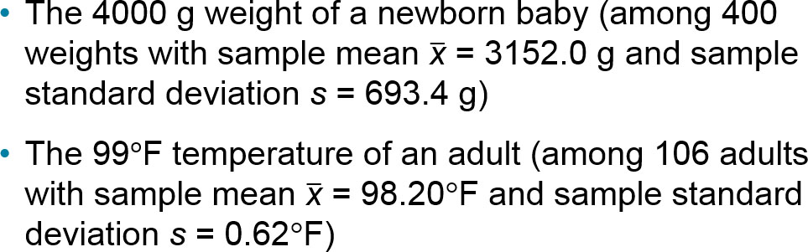
Example: Comparing a Baby’s Weight and Adult Body Temperature (1 of 3)
Which of the following two data values is more extreme relative to the data set from which it came?

Slide 8
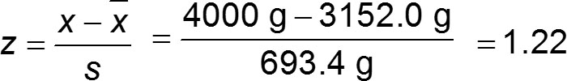

Example: Comparing a Baby’s Weight and Adult Body Temperature (2 of 3)
Solution
4000 g birth weight:

Slide 9
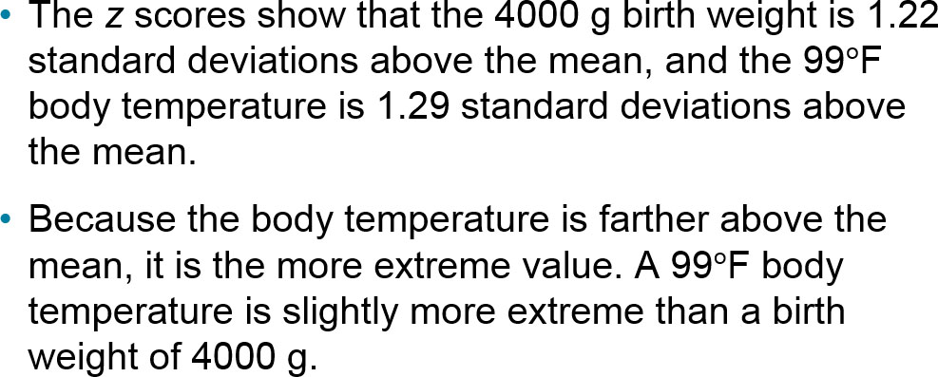
Example: Comparing a Baby’s Weight and Adult Body Temperature (3 of 3)
Interpretation

Slide 10
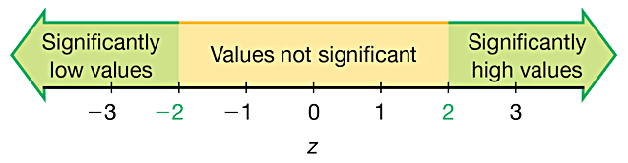
Using z Scores to Identify Significant Values
Significant values are those with
z scores ≤ −2.00 or ≥ 2.00.

Slide 11
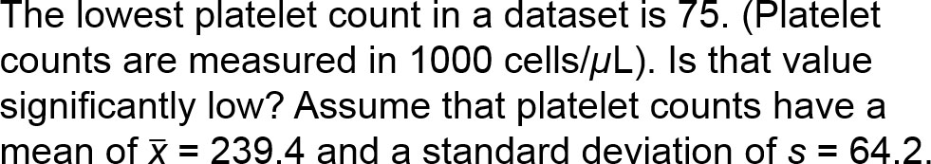
Example: Is a Platelet Count of 75 Significantly Low? (1 of 3)

Slide 12

Example: Is a Platelet Count of 75 Significantly Low? (2 of 3)
Solution
The platelet count of 75 is converted to a z score as shown below:

Slide 13
Example: Is a Platelet Count of 75 Significantly Low? (3 of 3)
Interpretation
The platelet count of 75 converts to the z score of −2.56. z = −2.56 is less than −2, so the platelet count of 75 is significantly low. (Low platelet counts are called thrombocytopenia, not for the lack of a better term.)

Slide 14
Percentiles
Percentiles
Percentiles are measures of location, denoted P₁, P₂, . . . , P₉₉, which divide a set of data into 100 groups with about 1% of the values in each group.

Slide 15
Finding the Percentile of a Data Value
The process of finding the percentile that corresponds to a particular data value x is given by the following (round the result to the nearest whole number):

Slide 16
Example: Finding a Percentile (1 of 3)
The airport Verizon cell phone data speeds listed below are arranged in increasing order. Find the percentile for the data speed of 11.8 Mbps.
0.8 | 1.4 | 1.8 | 1.9 | 3.2 | 3.6 | 4.5 | 4.5 | 4.6 | 6.2
6.5 | 7.7 | 7.9 | 9.9 | 10.2 | 10.3 | 10.9 | 11.1 | 11.1 | 11.6
11.8 | 12.0 | 13.1 | 13.5 | 13.7 | 14.1 | 14.2 | 14.7 | 15.0 | 15.1
15.5 | 15.8 | 16.0 | 17.5 | 18.2 | 20.2 | 21.1 | 21.5 | 22.2 | 22.4
23.1 | 24.5 | 25.7 | 28.5 | 34.6 | 38.5 | 43.0 | 55.6 | 71.3 | 77.8

Slide 17

Example: Finding a Percentile (2 of 3)
Solution
From the sorted list of airport data speeds in the table, we see that there are 20 data speeds less than 11.8 Mbps, so

Slide 18
Example: Finding a Percentile (3 of 3)
Interpretation
A data speed of 11.8 Mbps is in the 40th percentile. This can be interpreted loosely as this:
A data speed of 11.8 Mbps separates the lowest 40% of values from the highest 60% of values. We have P₄₀ = 11.8 Mbps.

Slide 19
Notation
n total number of values in the data set
k percentile being used (Example: For the 25th percentile, k = 25.)
L locator that gives the position of a value (Example: For the 12th value in the sorted list, L = 12.)
P_{k} kth percentile (Example: P₂₅ is the 25th percentile.)

Slide 20
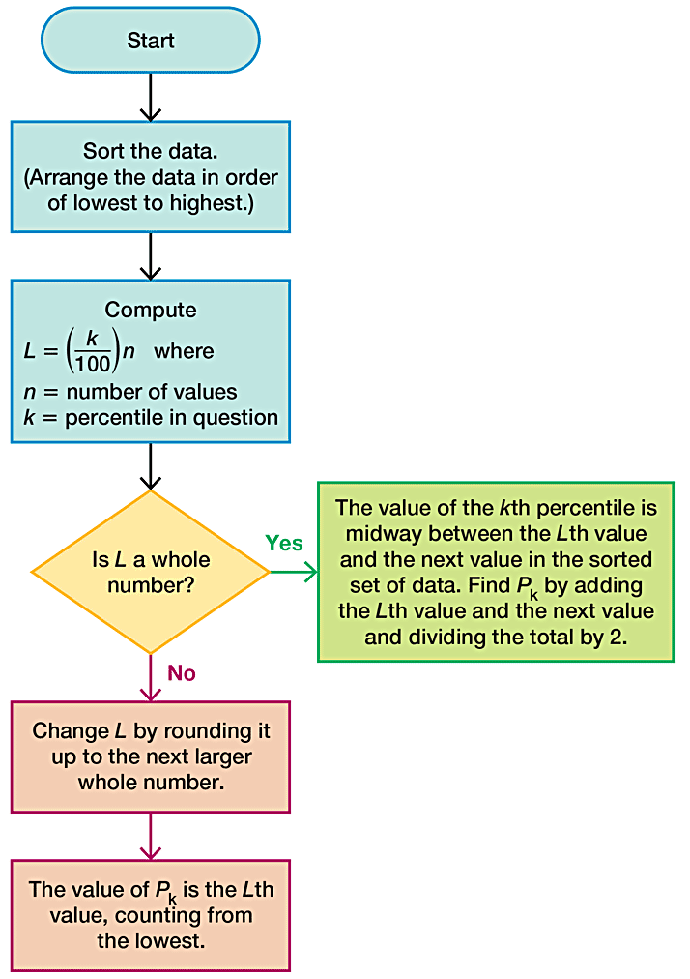
Converting a Percentile to a Data Value

Slide 21
Example: Converting a Percentile to a Data Value (1 of 4)
Refer to the sorted data speeds below. Find the 40th percentile, denoted by P₄₀.
0.8 | 1.4 | 1.8 | 1.9 | 3.2 | 3.6 | 4.5 | 4.5 | 4.6 | 6.2
6.5 | 7.7 | 7.9 | 9.9 | 10.2 | 10.3 | 10.9 | 11.1 | 11.1 | 11.6
11.8 | 12.0 | 13.1 | 13.5 | 13.7 | 14.1 | 14.2 | 14.7 | 15.0 | 15.1
15.5 | 15.8 | 16.0 | 17.5 | 18.2 | 20.2 | 21.1 | 21.5 | 22.2 | 22.4
23.1 | 24.5 | 25.7 | 28.5 | 34.6 | 38.5 | 43.0 | 55.6 | 71.3 | 77.8

Slide 22

Example: Converting a Percentile to a Data Value (2 of 4)
Solution
We can proceed to compute the value of the locator L. In this computation, we use k = 40 because we are attempting to find the value of the 40th percentile, and we use n = 50 because there are 50 data values.

Slide 23
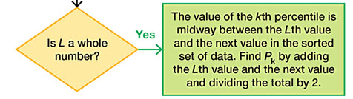
Example: Converting a Percentile to a Data Value (3 of 4)
Solution
Since L = 20 is a whole number, we proceed to the box located at the right.
We now see that the value of the 40th percentile is midway between the Lth (20th) value and the next value in the original set of data. That is, the value of the 40th percentile is midway between the 20th value and the 21st value.

Slide 24
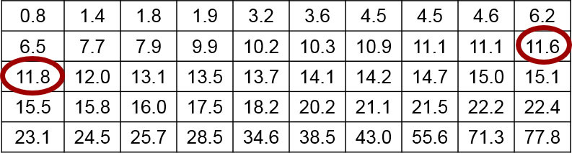
Example: Converting a Percentile to a Data Value (4 of 4)
Solution
The 20th value in the table is 11.6 and the 21st value is 11.8, so the value midway between them is 11.7 Mbps. We conclude that the 40th percentile is P₄₀ = 11.7 Mbps.

Slide 25
Quartiles
Quartiles
Quartiles are measures of location, denoted Q₁, Q₂, and Q₃, which divide a set of data into four groups with about 25% of the values in each group.

Slide 26
Descriptions of Quartiles (1 of 2)
Q₁ (First quartile):
Same value as P₂₅. It separates the bottom 25% of the sorted values from the top 75%.
Q₂ (Second quartile):
Same as P₅₀ and same as the median. It separates the bottom 50% of the sorted values from the top 50%.

Slide 27
Descriptions of Quartiles (2 of 2)
Q₃ (Third quartile):
Same as P₇₅. It separates the bottom 75% of the sorted values from the top 25%.
Caution Just as there is not universal agreement on a procedure for finding percentiles, there is not universal agreement on a single procedure for calculating quartiles, and different technologies often yield different results.

Slide 28
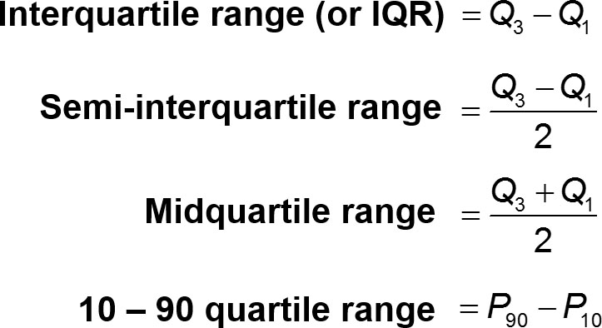
Statistics defined using quartiles and percentiles

Slide 29
5-Number Summary
5-Number Summary
For a set of data, the 5-number summary consists of these five values:
Minimum
First quartile, Q₁
Second quartile, Q₂ (same as the median)
Third quartile, Q₃
Maximum

Slide 30
Example: Finding a 5-Number Summary (1 of 3)
Use the Verizon airport data speeds to find the 5-number summary.
0.8 | 1.4 | 1.8 | 1.9 | 3.2 | 3.6 | 4.5 | 4.5 | 4.6 | 6.2
6.5 | 7.7 | 7.9 | 9.9 | 10.2 | 10.3 | 10.9 | 11.1 | 11.1 | 11.6
11.8 | 12.0 | 13.1 | 13.5 | 13.7 | 14.1 | 14.2 | 14.7 | 15.0 | 15.1
15.5 | 15.8 | 16.0 | 17.5 | 18.2 | 20.2 | 21.1 | 21.5 | 22.2 | 22.4
23.1 | 24.5 | 25.7 | 28.5 | 34.6 | 38.5 | 43.0 | 55.6 | 71.3 | 77.8

Slide 31
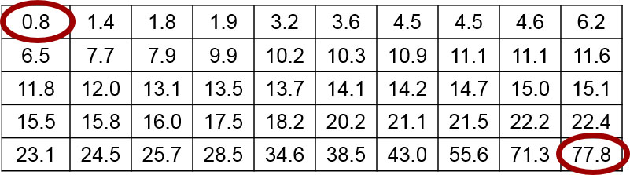
Example: Finding a 5-Number Summary (2 of 3)
Solution
Because the Verizon airport data speeds are sorted, it is easy to see that the minimum is 0.8 Mbps and the maximum is 77.8 Mbps.

Slide 32
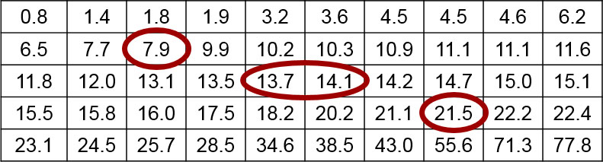
Example: Finding a 5-Number Summary (3 of 3)
Solution
The value of the first quartile is Q₁ = 7.9 Mbps. The median is equal to Q₂, and it is 13.9 Mbps. Also, we can find that Q₃ = 21.5 Mbps by using the same procedure for finding P_{75.}
The 5-number summary is therefore 0.8, 7.9, 13.9, 21.5, and 77.8 (all in units of Mbps).

Slide 33
Boxplot (or Box-and-Whisker Diagram)
Boxplot (or Box-and-Whisker Diagram)
A boxplot (or box-and-whisker diagram) is a graph of a data set that consists of a line extending from the minimum value to the maximum value, and a box with lines drawn at the first quartile Q₁, the median, and the third quartile Q₃.

Slide 34
Procedure for Constructing a Boxplot
Find the 5-number summary (minimum value, Q₁, Q₂, Q₃, maximum value).
Construct a line segment extending from the minimum data value to the maximum data value.
Construct a box (rectangle) extending from Q₁ to Q₃, and draw a line in the box at the value of Q₂ (median).

Slide 35
Example: Constructing a Boxplot (1 of 2)
Use the Verizon airport data speeds to construct a boxplot.
0.8 | 1.4 | 1.8 | 1.9 | 3.2 | 3.6 | 4.5 | 4.5 | 4.6 | 6.2
6.5 | 7.7 | 7.9 | 9.9 | 10.2 | 10.3 | 10.9 | 11.1 | 11.1 | 11.6
11.8 | 12.0 | 13.1 | 13.5 | 13.7 | 14.1 | 14.2 | 14.7 | 15.0 | 15.1
15.5 | 15.8 | 16.0 | 17.5 | 18.2 | 20.2 | 21.1 | 21.5 | 22.2 | 22.4
23.1 | 24.5 | 25.7 | 28.5 | 34.6 | 38.5 | 43.0 | 55.6 | 71.3 | 77.8

Slide 36
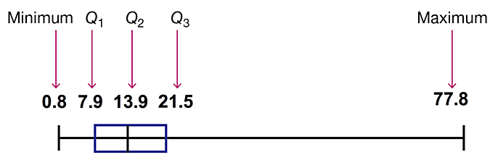
Example: Constructing a Boxplot (2 of 2)
Solution
The boxplot uses the 5-number summary found in the previous example: 0.8, 7.9, 13.9, 21.5, and 77.8 (all in units of Mbps). Below is the boxplot representing the Verizon airport data speeds.

Slide 37
Skewness
Skewness
A boxplot can often be used to identify skewness. A distribution of data is skewed if it is not symmetric and extends more to one side than to the other.

Slide 38
Identifying Outliers for Modified Boxplots
Find the quartiles Q₁, Q₂, and Q₃.
Find the interquartile range (IQR), where IQR = Q₃ − Q₁.
Evaluate 1.5 × IQR.
In a modified boxplot, a data value is an outlier if it is above Q₃, by an amount greater than 1.5 × IQR or below Q₁, by an amount greater than 1.5 × IQR.

Slide 39
Modified Boxplots
Modified Boxplots
A modified boxplot is a regular boxplot constructed with these modifications:
A special symbol (such as an asterisk or point) is used to identify outliers as defined above, and
the solid horizontal line extends only as far as the minimum data value that is not an outlier and the maximum data value that is not an outlier.

